Slide 1
Interesting facts about piramids
By Cătălin Pleșu

Slide 2
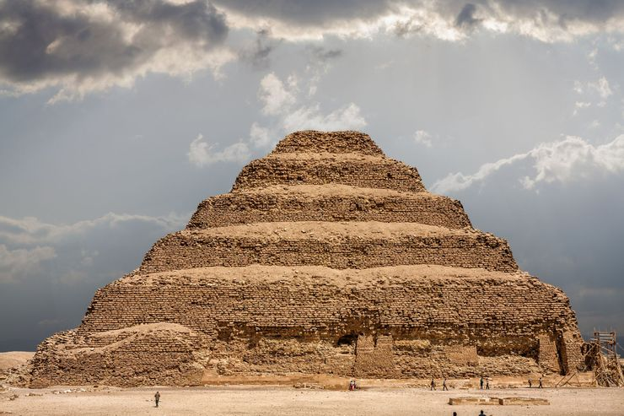
Some Had Flat Tops
We generally associate pyramids as a symmetrical triangle with a pointed top. This kind of pyramid was created by Egyptians .Their pyramid consisted of six layers and traveled 3.5 miles underground.

Slide 3
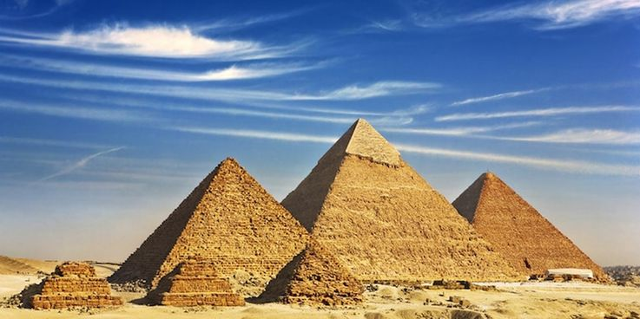
They Weren't The Only Structure Built
Pyramids had a religious purpose and in addition to them there were built other structures , for example the pyramids were surounded by chapels, tombs and temples to help them reach the place were souls were supose to go in afterlife

Slide 4
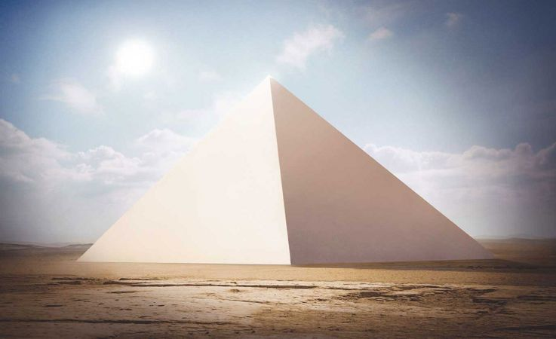
They Used To Sparkle
In our days pyramids look dull but in the past they used to reflected the light like a mirror because they were covered with polished limestone and this made them extremely visible.

Slide 5
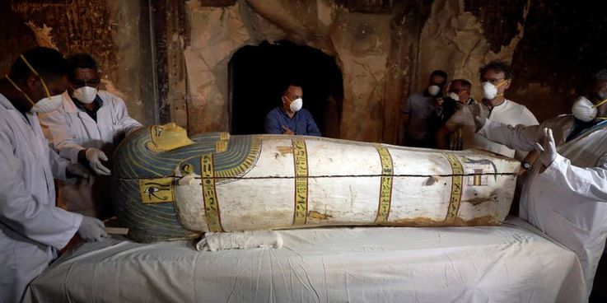
Many Of Them Were Robbed
Plenty of history was lost because of tomb robbers. The pyramids were their target because the kings and the queens were buried with untold amounts of riches. Stealing from pyramids was offending and who was caught was executed.

Slide 6
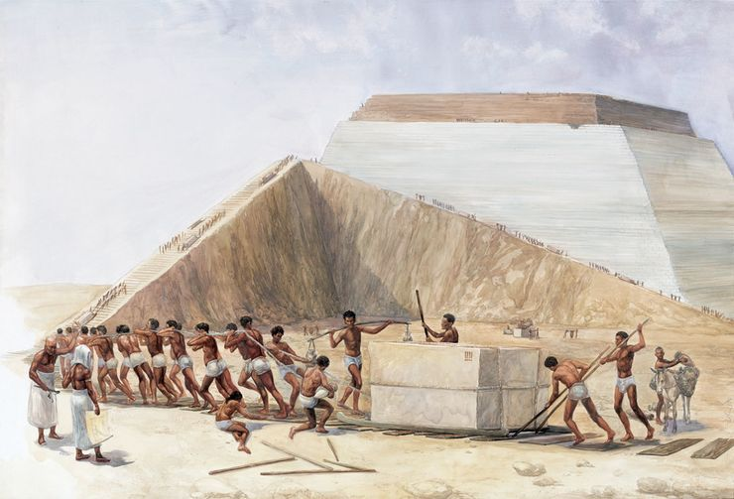
It Is Still A Mystery How They Built Them
Pyramids were studied for years and there have been developed several theories some developed even 2000 years ago .The most accepted theory is that the pyramids were built form inside using ramps

Slide 7
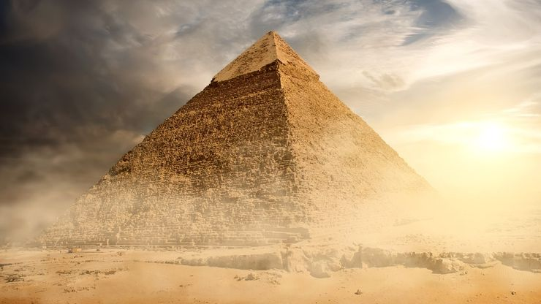
The Great Pyramid Of Khufu Weighs 5,750,000 Tons
The great pyramid is composed of 2.3 million blocks of stone , each is weighting about 2.5 tons.

Slide 8
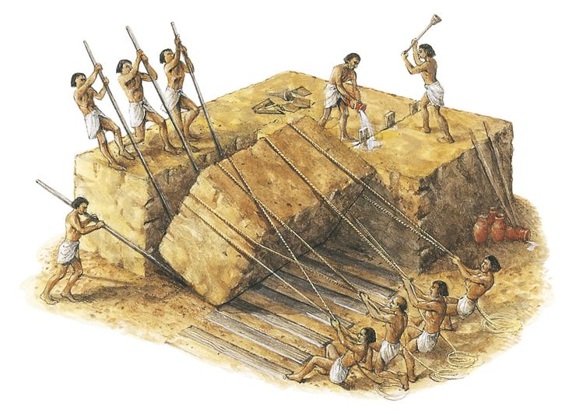
They Took About 23 Years To Complete
If we think haw long it takes to repair Chișinău-s bypass belt you wont have any doubt that 23 years for a 5,750,000 ton construction isn’t so much.

Slide 9
Keywords
Time
Mass
Tomb robbers
Tomb
Religion
Beauty
Pharaoh
Richness
History
Mystery
Engineering
Curse
Wall Paintings aka graffiti

